Slide 1

Predicting Loan Risk
Group8:
Phanindra Panthagani
Prithvi Gude
Medichelmala Shiva Teja
Monisha Prakash
Shuba Hanuman

Slide 2

Avocado
Analytics
Peel the data. Heal the data. Feel the data

Slide 3



Introduction
Problem – Loan defaulters
Client – Chase bank
Solution - ??

Slide 4

Scenes at Avocado Analytics

Slide 5


Chase bank risk management team meets Avocado Analytics

Slide 6

Meet no.1

Slide 7

Listen what they talk!

Slide 8


Before
After

Slide 9

Why you no repay loans?

Slide 10

What do we do?

Slide 11

Need a month time

Slide 12



Avocado Analysts at work

Slide 13
Meet no.2

Slide 14

Peel the data

Slide 15
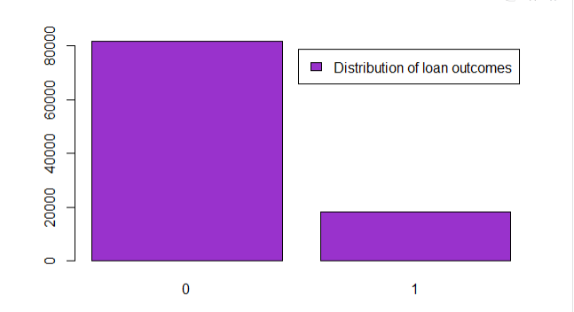
EXPLORATORY DATA ANALYSIS
0- Full paid
1- Default

Slide 16
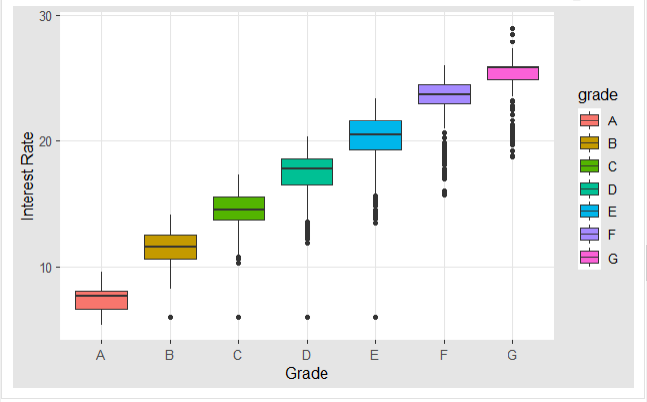
Exploring the relationship between the numeric variable Interest Rate and the factor Grade

Slide 17
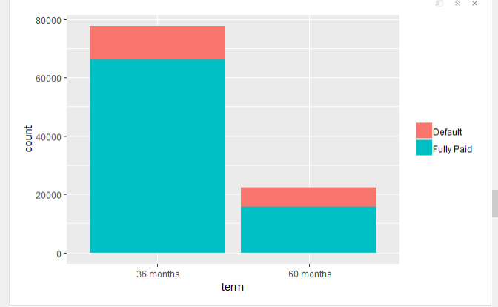
Grouping based on term and interpreting the results for the output variable loan_outcome
 | 36months | 60months
Loan outcome=0(Fully paid) | 66000/78000=84.6% | 16000/22000=72.7%
Loan outcome=1(Default) | 12000/78000 = 15.4% | 6000/22000=27.3%

Slide 18
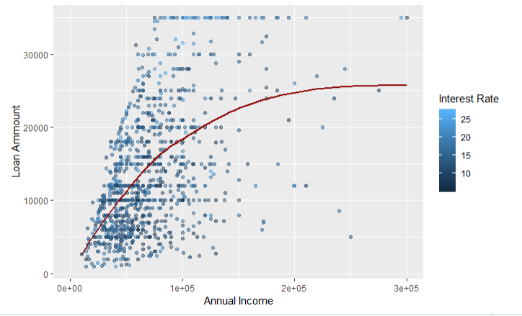
Exploring the impact of annual income on loan_amount and int_rate

Slide 19
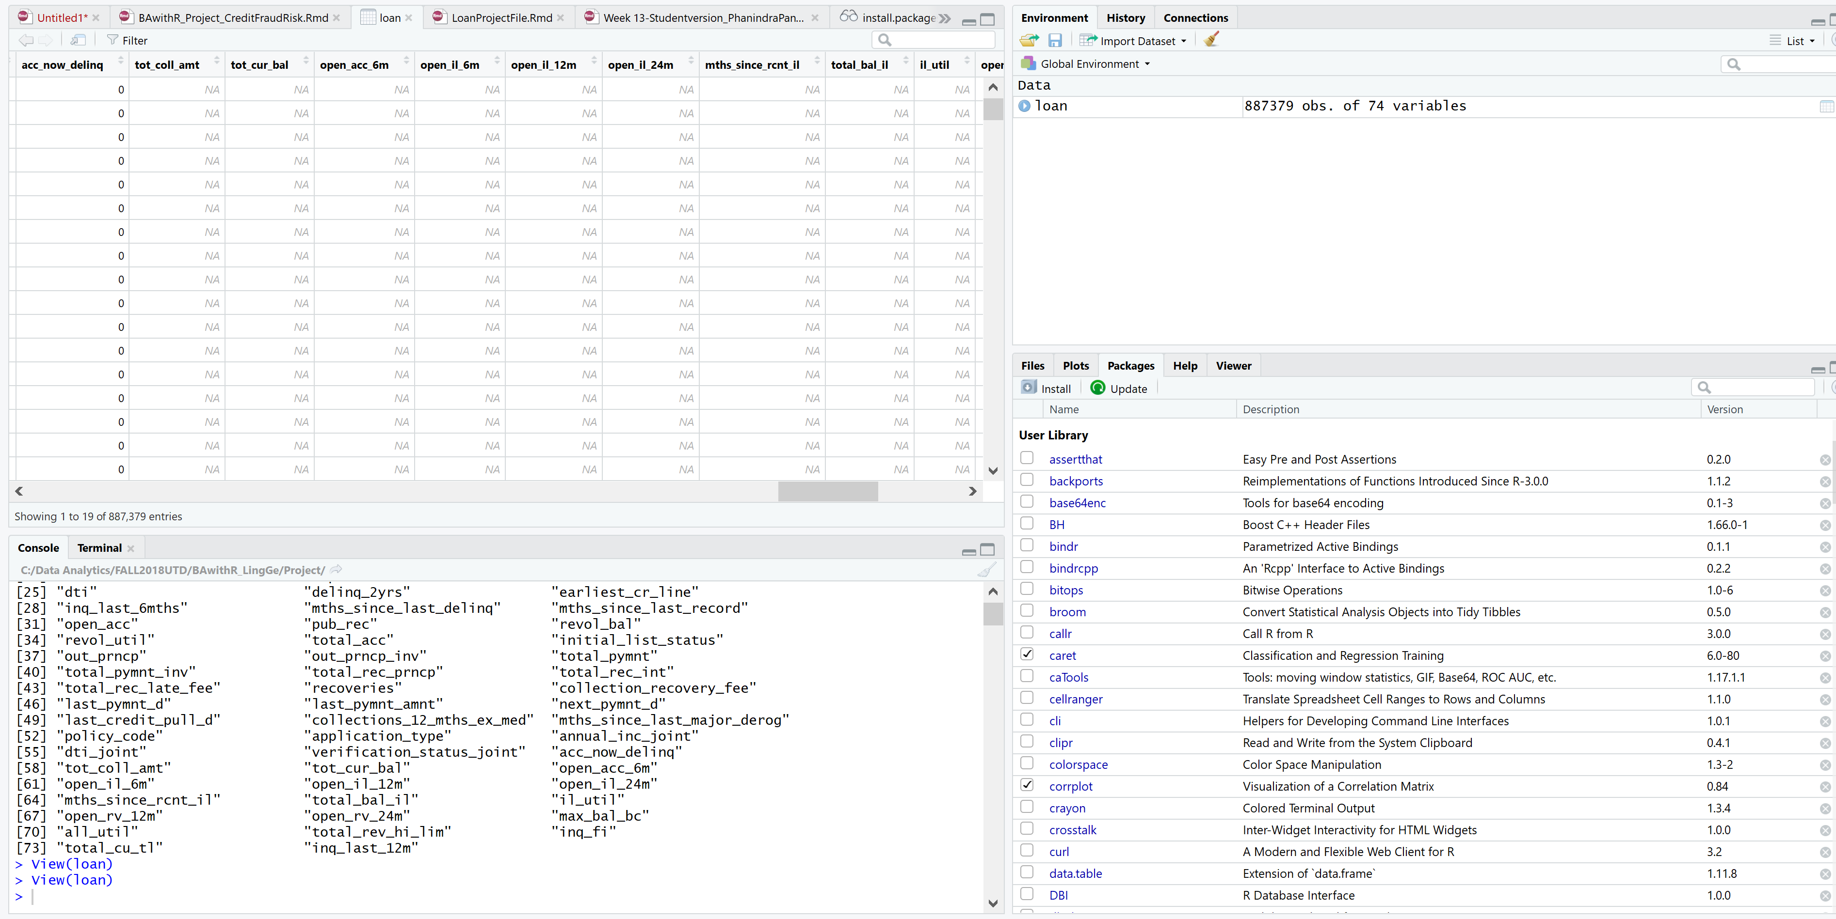
Feature Selection

Slide 20
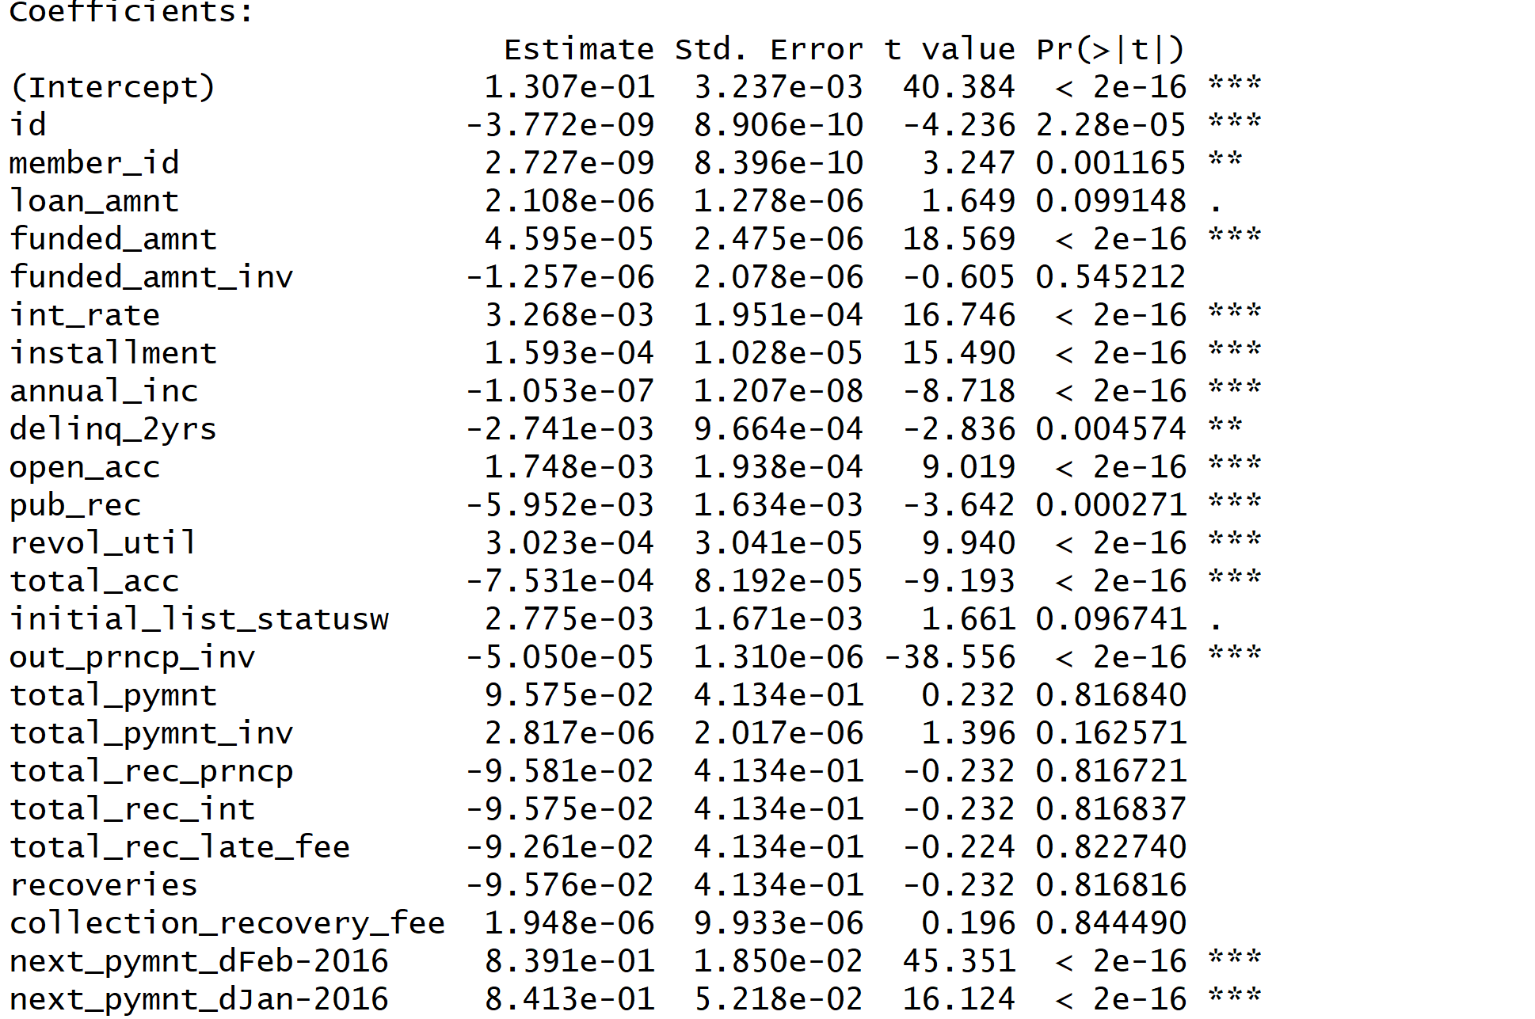
Choosing important numerical factors
Choosing important numerical factors
Initial data set - 8,87,000 * 74
Peeled (cleaned) data set – 2,50,000*14
Training set :75% ; Test set : 25%
loan2master : int_rate,installment,annual_inc ,open_acc,pub_rec,revol_util,total_acc,out_prncp_inv, loan_amnt , grade , emp_length , home_ownership ,term,loan_outcome

Slide 21
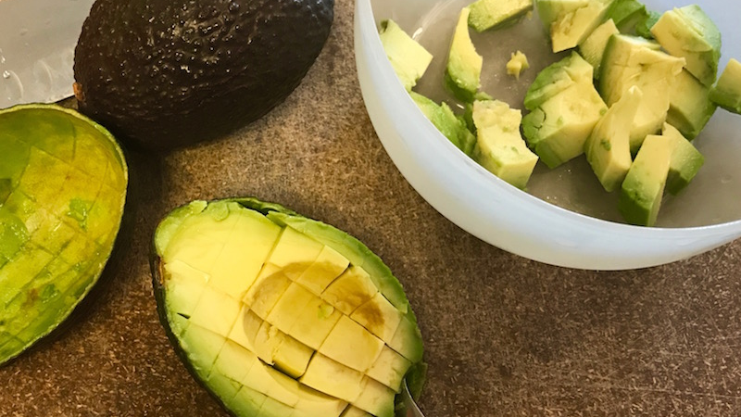
Heal the data

Slide 22
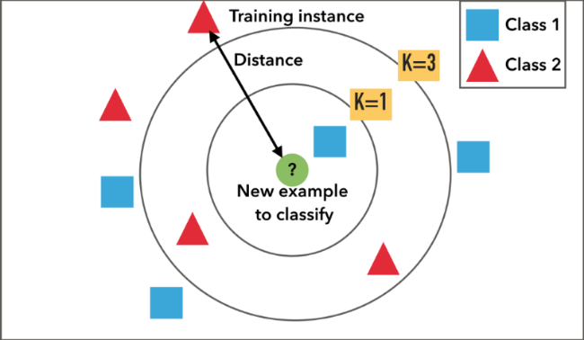
KNN

Slide 23
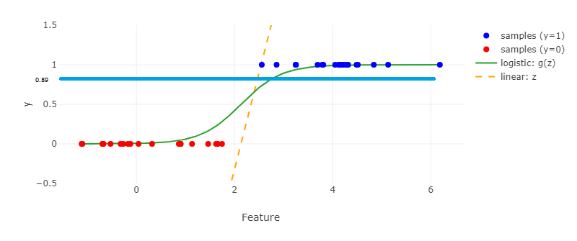
Logistic Regression
Probability of default p is the probability that a particular person is not able to repay the loan which can be obtained from logistic regression
The optimum threshold for logistic regression came out to be 0.89 which is equal to mean(probability)+3.19*std(probability of default)
If a new person’s details are given , this probability can be found out from the logistic model and if the probability comes out to be greater than 0.89 then the person will be a defaulter.

Slide 24
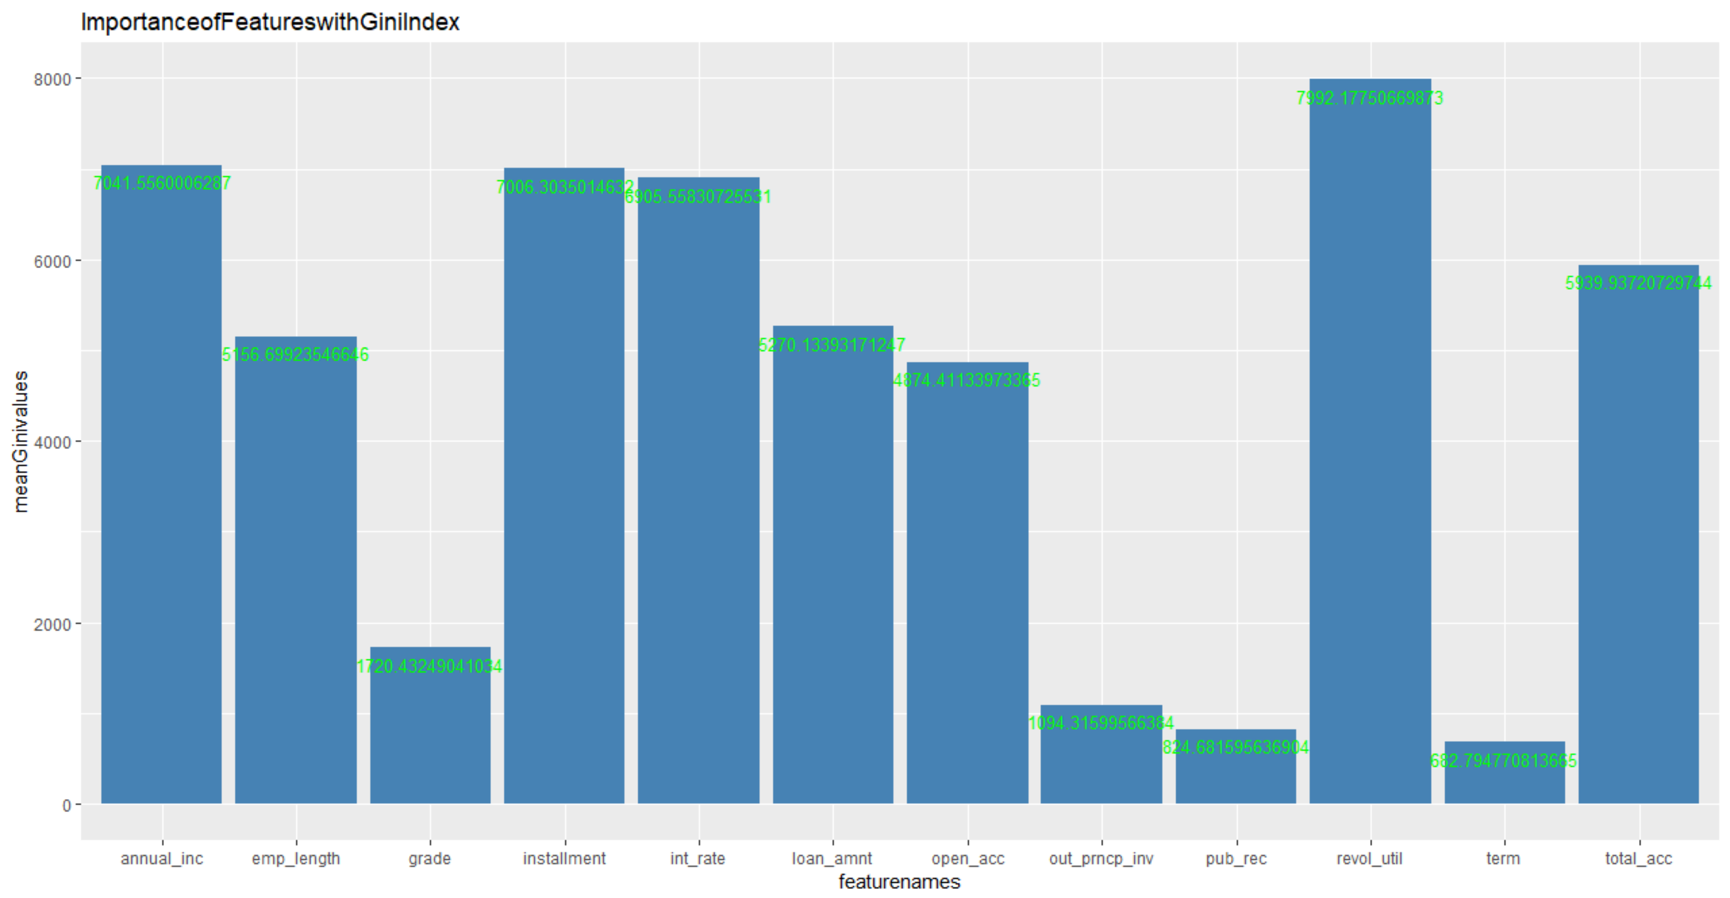


Random Forests
The graph represents the mean decrease in node impurity (and not the mean decrease in accuracy). We can also visualize Partial Response Plots, as suggested in Friedman (2001), in the context of boosting.
It is possible to evaluate the importance of each variable when predicting by adding up the weighted impurity decreases for all nodes where is used (averaged over all trees in the forest, but actually, we can use it on a single tree)
where the second sum is only on nodes t based on variable . . If is Gini index, then is called Mean Decrease Gini function. Here is each feature.
Given an impurity function such as Gini index we split at some node if the change in the index
Notes:
Reference : https://www.r-bloggers.com/variable-importance-plot-and-variable-selection/

Slide 25

Feel the data

Slide 26
Classifier | Trainset variables | Accuracy | Loop and optimum values if any | Threshold if any
Logistic Regression | loan2master | 82.29% | Optimum value of threshold is Mean+3.19*std Optimum threshold value =0.89 | Mean+0.01*std to Mean+4*std
KNN | loan2onlynumeric | 82.14% | Optimal value of K is 36 | K=1 to 360
LDA | loan2onlynumeric | 82.03%
Random Forest | loan2master | 82.17% | Ntree=900
Model Evaluation
loan2master : int_rate,installment,annual_inc ,open_acc,pub_rec,revol_util,total_acc,out_prncp_inv, loan_amnt , grade , emp_length , home_ownership ,term,loan_outcome
loan2onlynumeric : funded_amnt,int_rate,installment,annual_inc ,open_acc,pub_rec,revol_util,total_acc,out_prncp_inv, loan_amnt ,loan_outcome

Slide 27
Conclusion
The best classifier after healing the data came to be logistic regression with a threshold of 0.89. That is you give us a person’s details and we will put it in our model and give you the probability p. if the probability p is greater than >0.89 that person is a defaulter.
Logistic Regression came out to be the king for binary classification! Although, we let the data speak.

Slide 28



Whooooooooosh!

